Slide 1
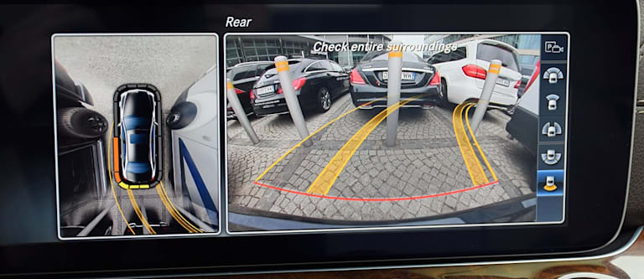
EE551 2023 mini-project
EE551 2023 Mini-Project:
Automotive surround view system with park slot detection
Deadline: Midnight, Sunday, April 9th
Percentage of total grade: 50%

Slide 2
Project Description
In this project, you will implement an automotive surround view system with park slot detection
Generate a birds eye view from the input cameras
Identify an open park slot (see right mono images)
This implementation will be based on aspects covered throughout the course of the module including
Raw sensor to RGB image generation (Assignment 1)
Fisheye calibration and distortion correction
Image merge
Lane detection
Object detection
Segmentation

Slide 3
Project Dataset and resources
For this project, you will use images from the Oxford Robotcar dataset
robotcar-dataset.robots.ox.ac.uk
This dataset contains data from 3 fisheye cameras, a 3 camera front stereo camera system, radar and lidar data
The images files you will need for the mini-project are provided on Blackboard

Slide 4
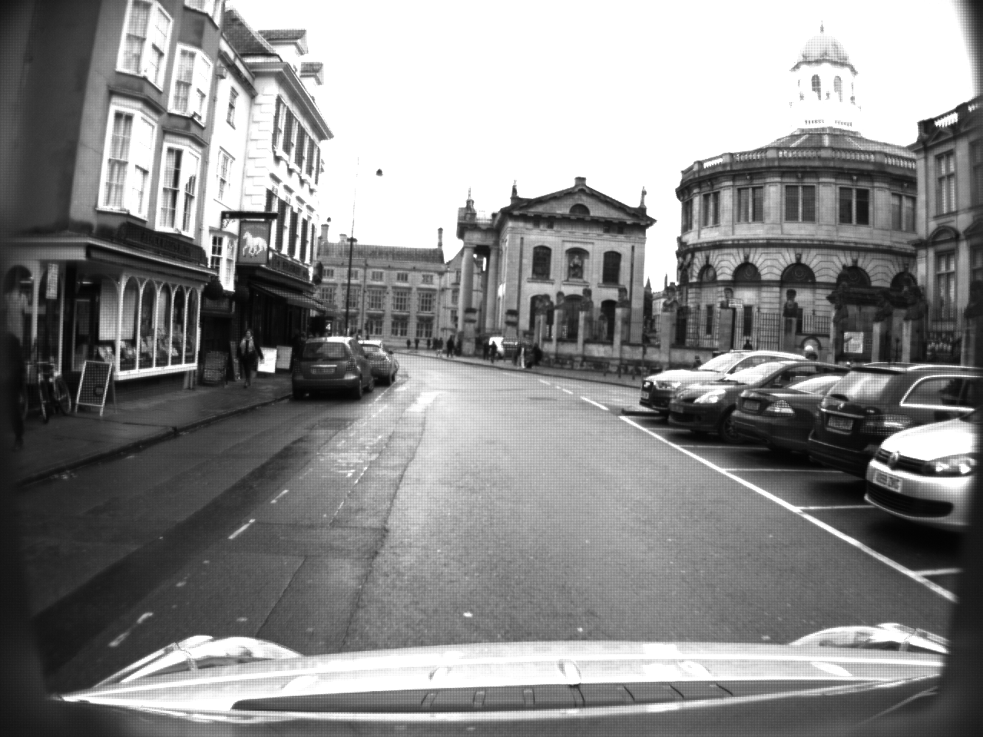
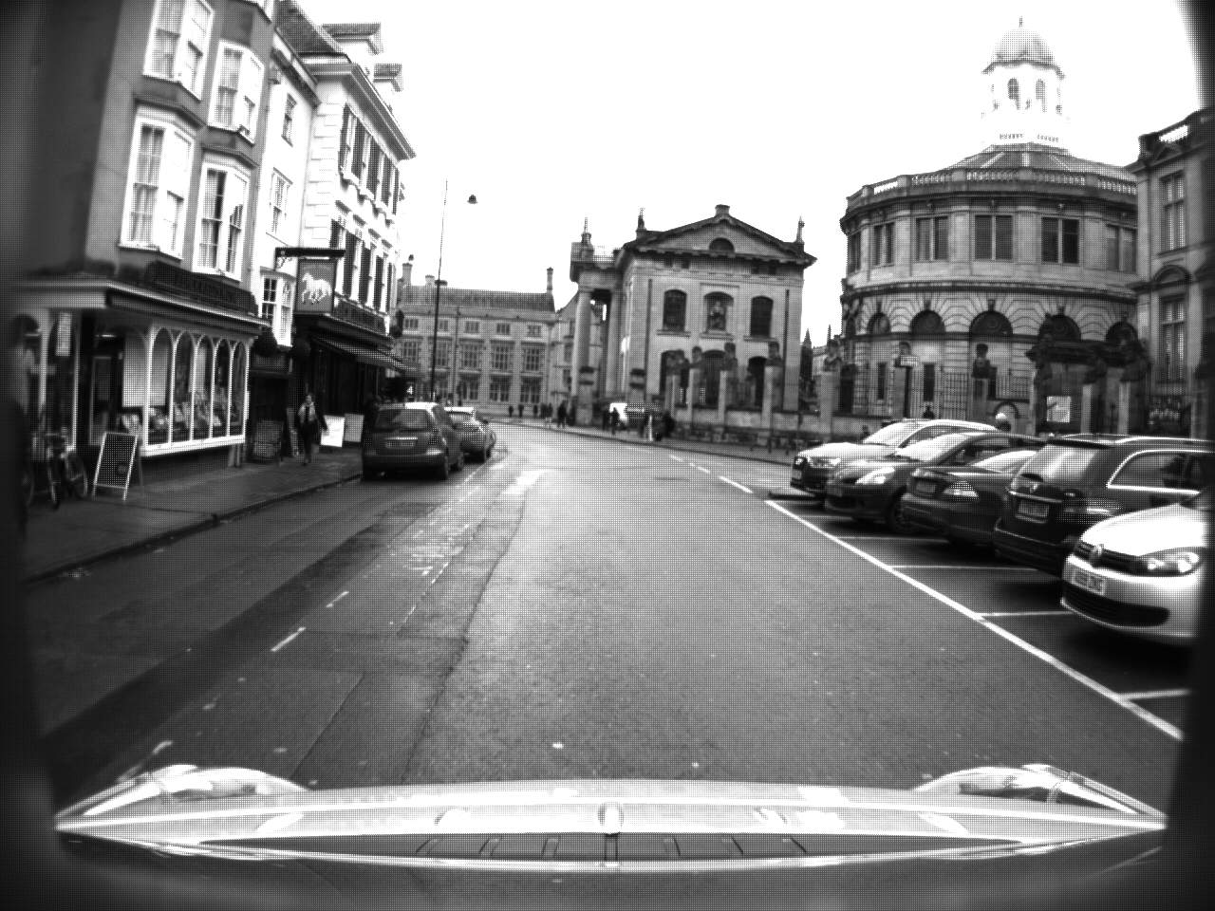
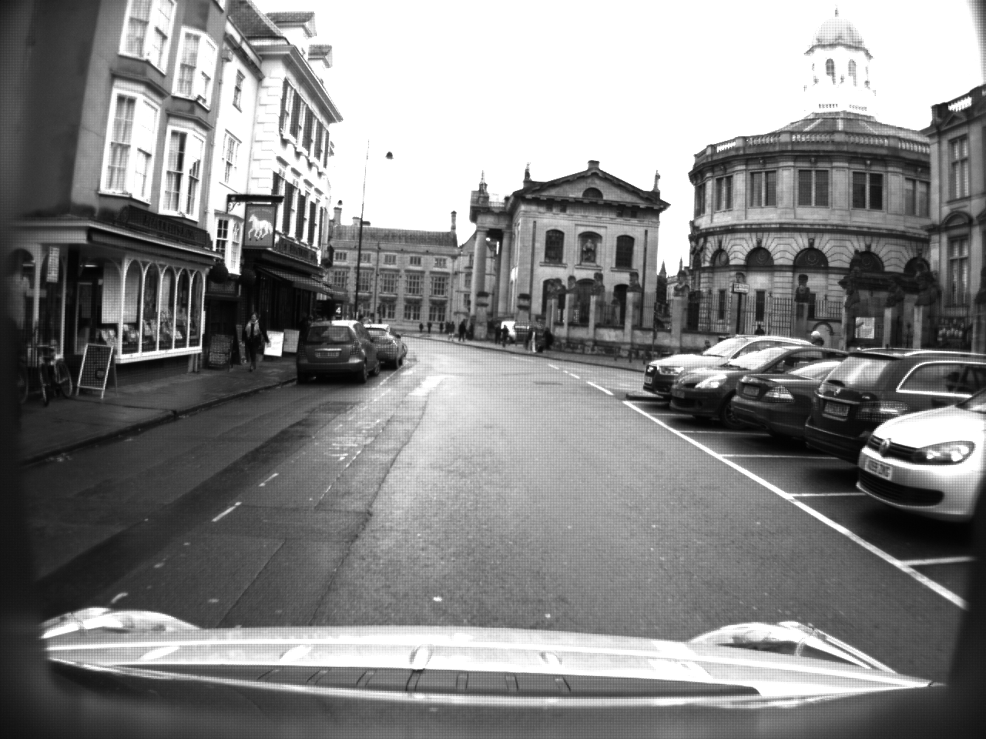
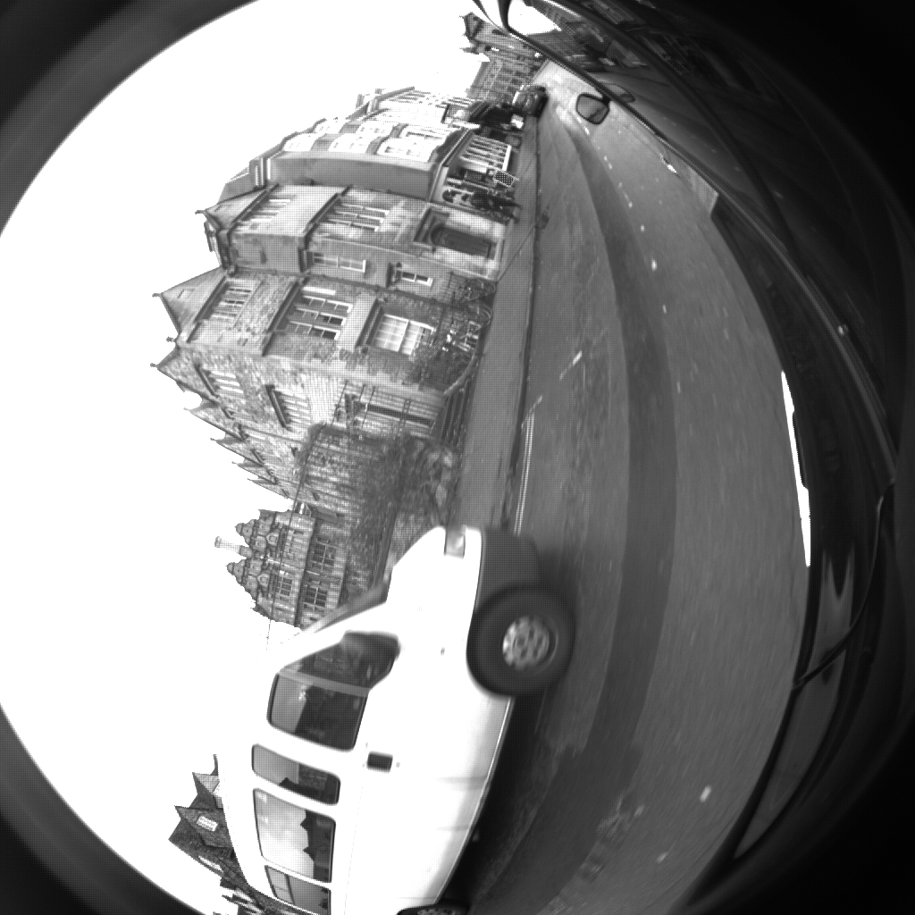
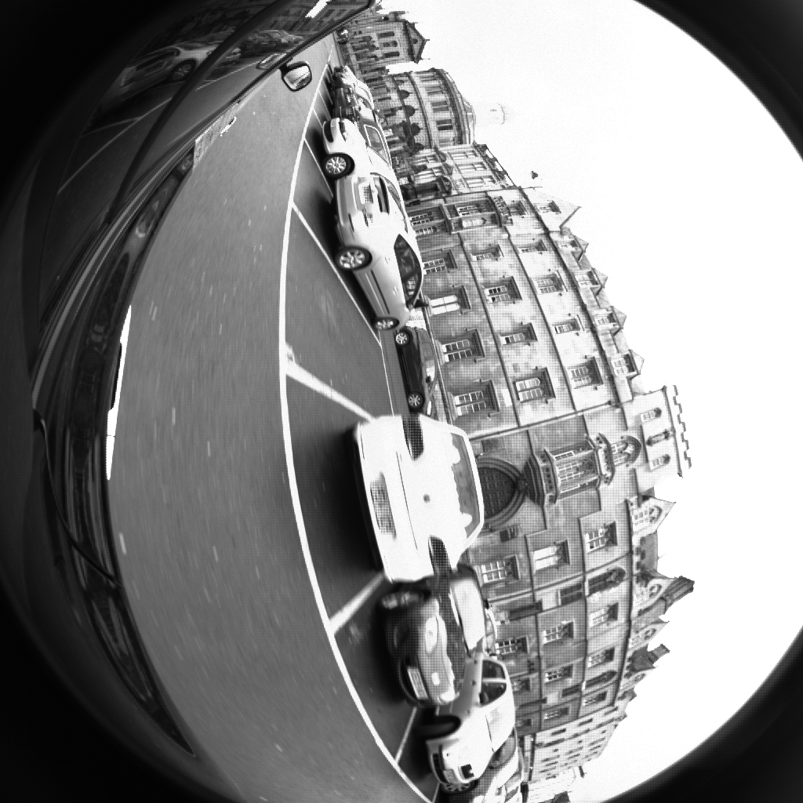
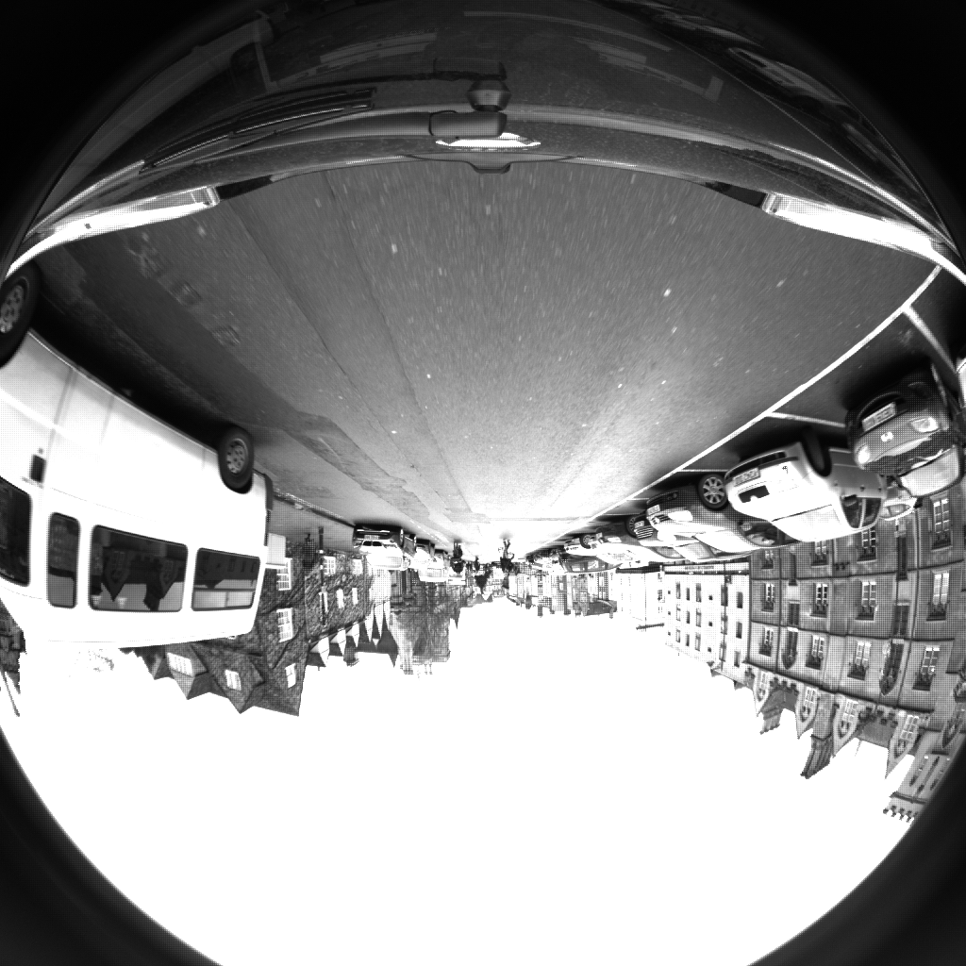
Project Dataset and resources
The camera images are stored in png format, and are raw sensor image files
Example images are shown opposite:

Slide 5
Project dataset and resources
The dataset is also accompanied by a github repo
https://github.com/ori-mrg/robotcar-dataset-sdk
This repo contains a number of useful tools for this project, including
Demosaic function (convert raw image to RGB)
Camera model containing:
Camera extrinsics
Camera distortion model
Function to perform perspective correction
i.e. you will not need to calibrate the cameras as per assignment 3, this is already done in the github code

Slide 6
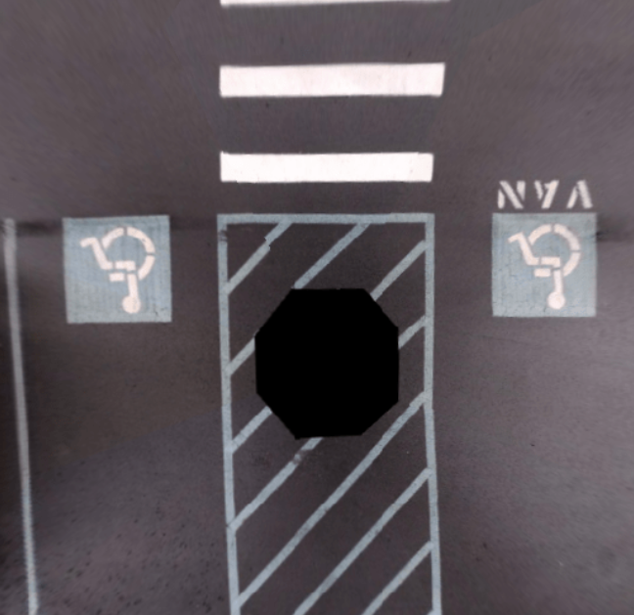
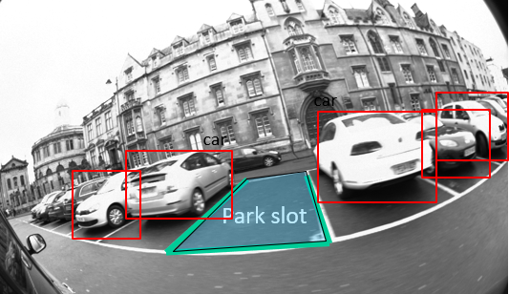
Project task 1 – Generate topview
Topview
Park slot detection view
Implement an automotive surround view system, using the Oxford robotcar dataset and related tools
The resolution of the combined output shall be 1280*800 pixels
800
1280

Slide 7
Project task 1 – Generate topview
Note that to generate the topview, you will need to merge the views from 6 cameras (stereo front, left, right, and mono left, rear, right)
Grading of the topview will be based on the following criteria
Quality of geometric correction, homography etc
i.e. do the cropped zones line up correctly, are they straight etc
Merge quality (smoothness of transition between merged camera images)
Brightness and colour matching
Correction of differences in colour and brightness between cameras in the topview

Slide 8
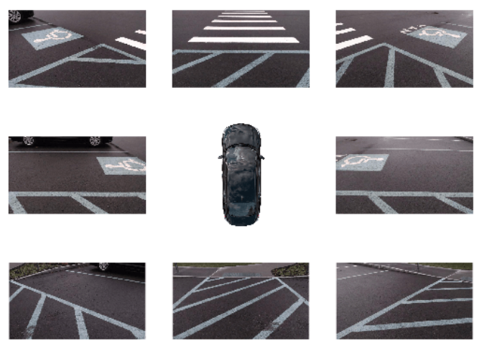
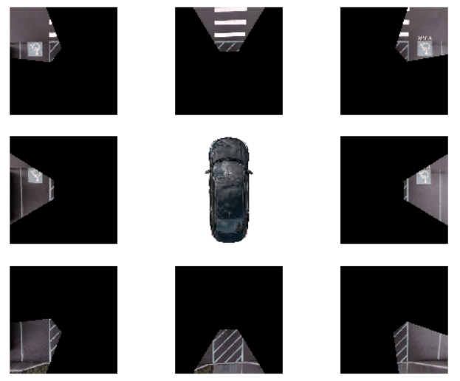
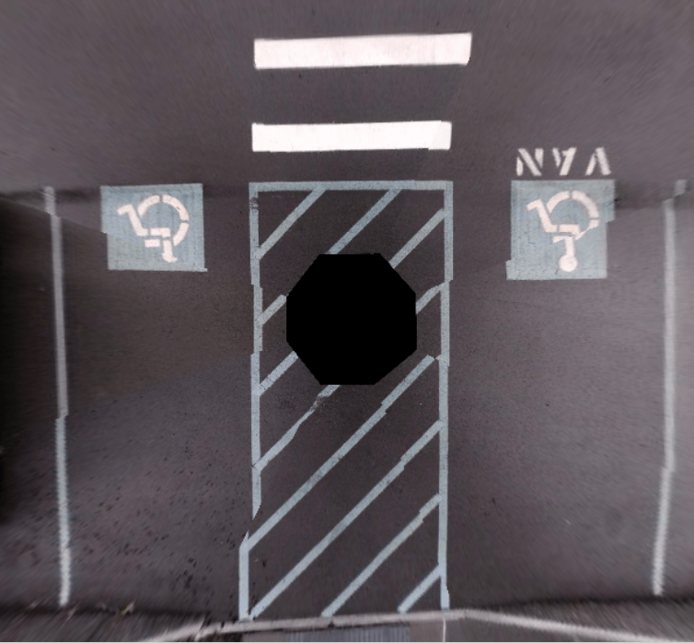
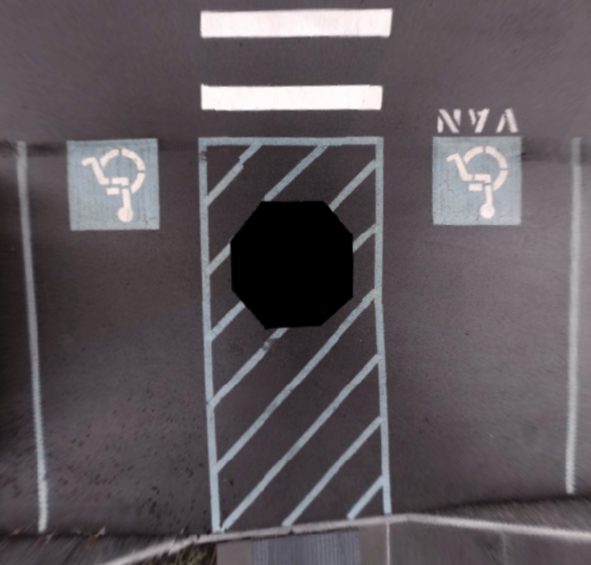
Project task 1 – Generate topview
Distortion correction
Crop
Merge
Align
Typical workflow for topview image generation

Slide 9
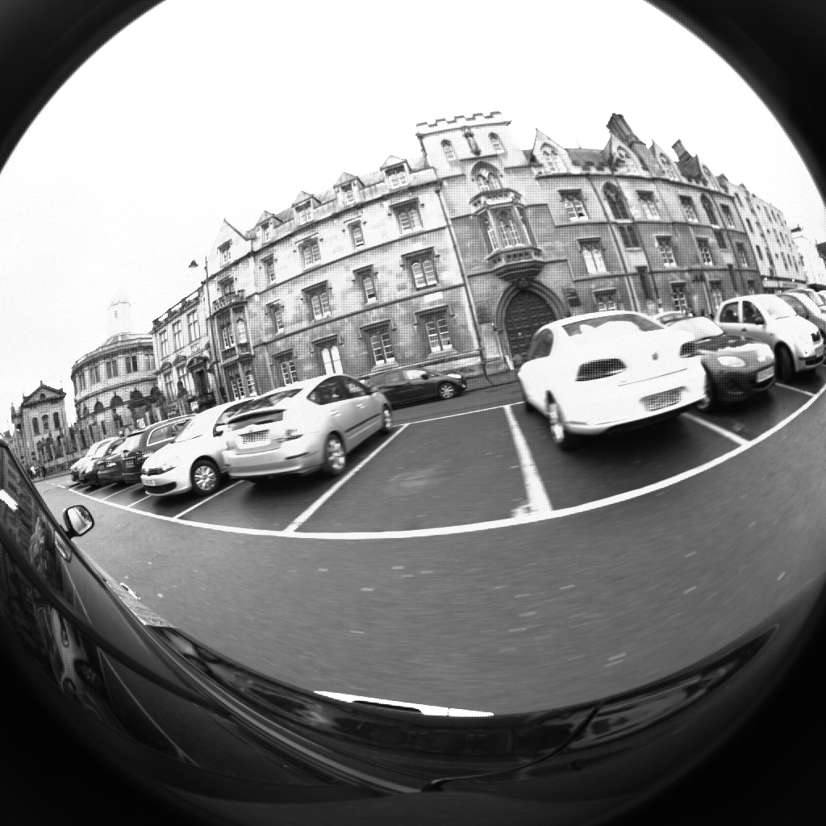
Project task 2 - Park slot detection
In the test images, there is a vacant park slot (see image)
The task for this project is as follows:
Detect parked cars
Detect parking lines
Detect and segment the available park slot
Note: there is no need to detect parked cars in other camera views, just the right camera is sufficient
car
car
car
car
car
Park slot

Slide 10
Additional comments
Feel free to select whichever method of line detection, object detection (to identify parked cars) and segmentation you wish:
Use a pre-existing “out of the box” implementation, there is no need to design or implement a new semantic segmentation model
You must justify your choice in terms of performance, computation complexity and real-time considerations
The project description does allow some flexibility regarding implementation. Use your best judgement to implement your solution, and document your decisions
Due to time and resource constraints, there is no need to re-train your algorithm on this dataset

Slide 11
Submission
Submit a Jupyter Notebook, including all code and documentation
While it is ok to collaborate, each person must submit their own work (i.e. this is an individual project, not a group project)
Include all analysis and commentary in the Notebook
Including justifications for model selection, approaches and design decisions taken etc
It is ok to use existing tools, code bases etc. However, it is required to reference and provide links to any tools or 3rd party code/scripts used

Slide 12
Submission
Grading (out of 100%):
Topview Generation: 40%
Park slot detection:
Parking lines detection: 20%
Object Detection (parked cars): 20%
Semantic Segmentation of park slot: 20%
Code quality, discussion of project design, implementation, limitations and potential improvements will be considered for grading

Slide 13
Additional comments
Dedicate some time at the start to planning your project
Some tasks are more difficult than others. Start by implementing the easier parts where possible
If a particular aspect is proving difficult, consider implementing a more basic version first, then revisiting a more complex solution

